Slide 1




EXCELSSIOR EDUCATION SOCIETY’S K. C. COLLEGE OF ENGINEERING AND MANAGEMENT STUDIES AND RESEARCH (Affiliated to the University of Mumbai) Mith Bunder Road, Near Hume Pipe, Kopri, Thane(E)-400603
Department of Computer Engineering
Academic Year 2023-24(Odd Semester)

Slide 2
Index
Introduction to Topic
Need of Project
Problem Statement
Literature survey
Algorithm for Project Development
Block Diagram/ Architecture
Flow-chart
Requirement Hardware and Software
Feasibility Study
Proposed Methodology
Data Flow Diagram
Activity Diagram
Implementation Details/ Screenshots of GUI

Slide 3
Introduction
"Hand Cricket" is a specially crafted Android application that aims to bring the cherished street game of Hand Cricket into the digital realm, providing users with an enthralling and interactive experience. This app serves as a virtual playground for those who fondly remember playing Hand Cricket during recess in school. It transforms the traditional game into an engaging digital format, allowing players to indulge in thrilling matches.

Slide 4
Need of Project
1. Rekindling Nostalgia: I was inspired by the nostalgia associated with hand cricket. This game is a cherished part of many people's childhoods, and I wanted to create a digital version that could help people relive those joyful moments.
2. Spreading Joy: Hand cricket is a game that transcends age and boundaries. It brings a smile to the faces of people, young and old. I wanted to share this joy with a broader audience, not just those who are familiar with it but also the newer generations who may have never experienced it.
3. Preserving Traditions: Hand cricket is a traditional street game that, in many places, is gradually fading into obscurity due to changing lifestyles and technologies. I wanted to contribute to preserving this wonderful tradition by bringing it into the digital age.

Slide 5
Problem Statement
In today's increasingly digitalized world, traditional street games like hand cricket are at risk of fading into obscurity, as they struggle to adapt to the changing interests and lifestyles of the newer generations. The absence of easily accessible and engaging digital platforms that faithfully replicate the hand cricket experience leaves enthusiasts and newcomers without a means to enjoy this beloved game. There is a pressing need to bridge the gap between the nostalgia associated with hand cricket and the digital age, preserving the tradition while making it accessible, enjoyable, and competitive for players of all ages. The problem at hand is the lack of an interactive and user-friendly application that captures the spirit of hand cricket and allows players to engage in the game with a computer-controlled opponent, thereby ensuring the survival and enjoyment of this cherished tradition in a modern context.

Slide 6
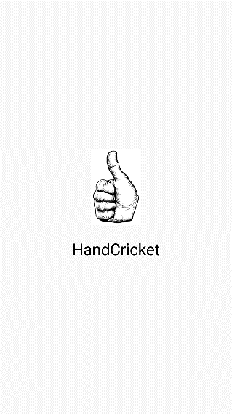

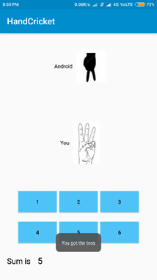
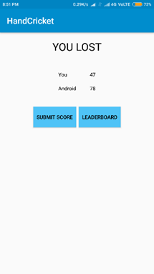
Literature Survey
Few hand cricket applications created by lone developers are available on the internet. One such application is “Hand Cricket” by shijinmathew012 on GitHub.
Source: - shijinmathew012/HandCricket: Android app of handcricket game (github.com)

Slide 7
Algorithm for Project Development
Project Initiation: Defined project objective: Create a mobile Hand Cricket game.
Planning and Design: Design the game architecture with components. Decide on the technology stack for mobile app development. 3. Design user interfaces with basic animations to enhance user experience.
Development: Build the mobile app, implementing game logic, UI, and animations. Implement backend code.
Testing: Test the app for functionality, user-friendliness, and performance. Address and fix any identified issues.
User Testing: Conduct beta testing with a small group to gather user feedback. Make improvements based on user suggestions.
Post-Project Review: Evaluate project performance against objectives. Identify areas for improvement and lessons learned.

Slide 8
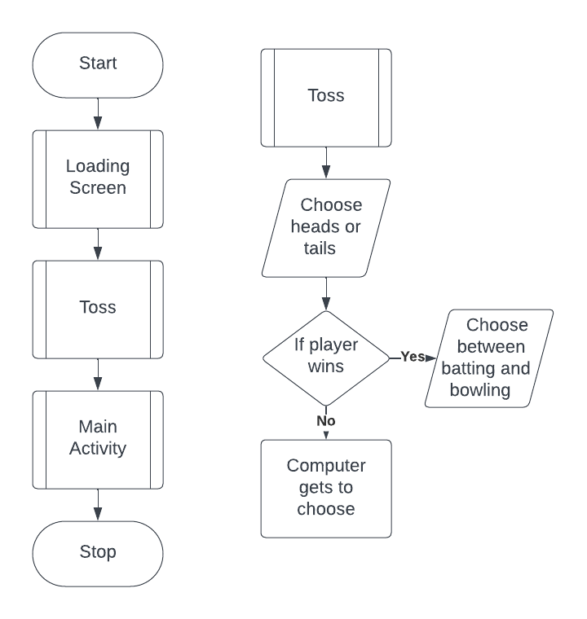
Block Diagram / Architecture

Slide 9
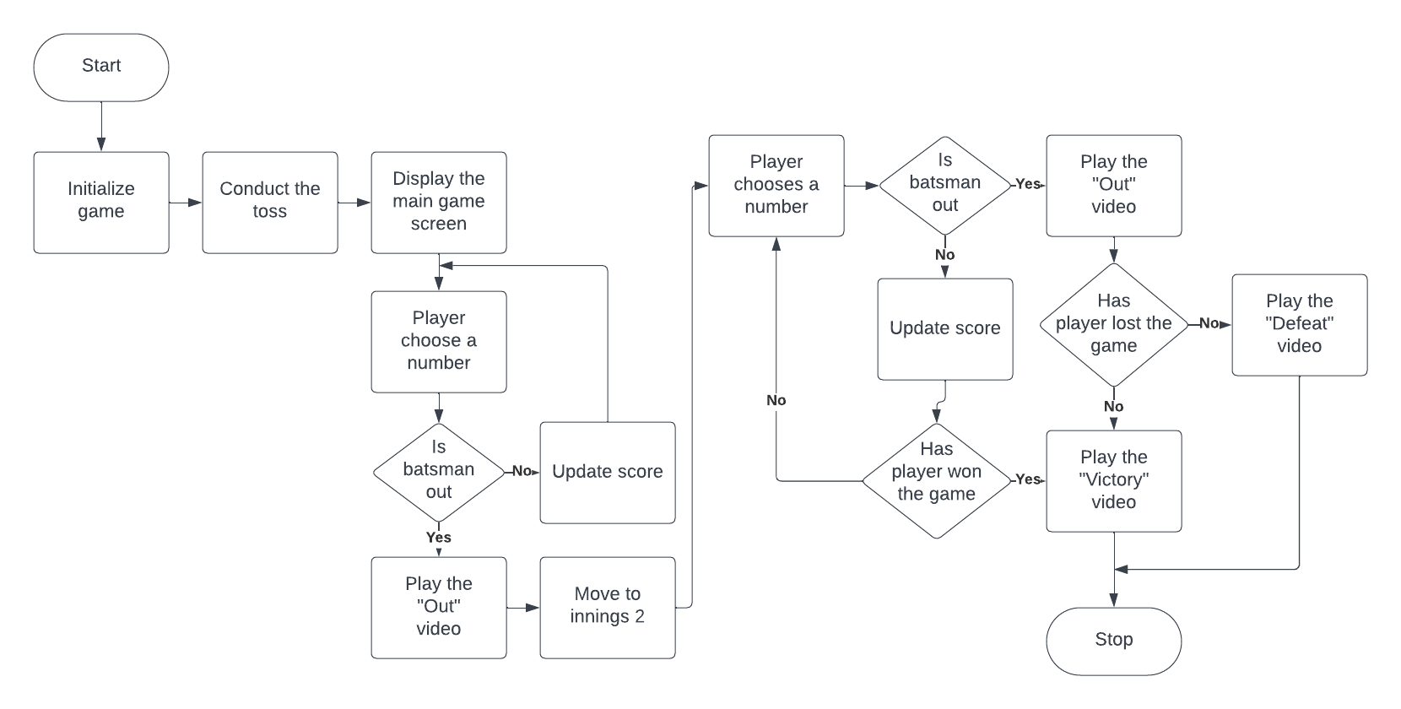
Flowchart

Slide 10
Requirements
Hardware Requirements: -
i. Touch Screen Interface inclusive Device
ii. 2 GHz or greater Multi Core Processor
iii. 4 GB or more RAM
iv. 2 GB Available Storage
Software Requirements: -
Android 13 and above with API level 33 and above

Slide 11
Feasibility Study
Technical Feasibility: The project can be technically implemented with readily available development tools and expertise. Animations can be effectively integrated.
Operational Feasibility: The project aligns with the developer's capabilities and resources. Integration into existing operations is feasible.
Legal and Regulatory Feasibility: No significant legal barriers are foreseen, and compliance with app store guidelines is ensured.
Scheduling and Time Feasibility: Project timelines allow for timely development and deployment.

Slide 12
Proposed Methodology
Project Initiation: Define the objectives and scope of the mobile Hand Cricket game project. Assess project feasibility, including resource availability and timeline constraints.
Planning and Design: Develop a detailed project plan with milestones and deliverables. b) Choose the technology stack for mobile app development. c) Create the game design, including the user interface (UI) and basic animations.
Development: Build the mobile app, implementing game logic, UI, and animations.
Testing and Quality Assurance: Conduct rigorous testing, including functionality, user-friendliness, and performance. Address and resolve any identified issues or bugs.
User Testing: Conduct user testing with a small group to gather feedback. Make improvements based on user suggestions and usability testing.
User Guides: Include in-app help and instructions for playing the game.
Project Closure: Verify that all project deliverables are complete and meet required standards.

Slide 13
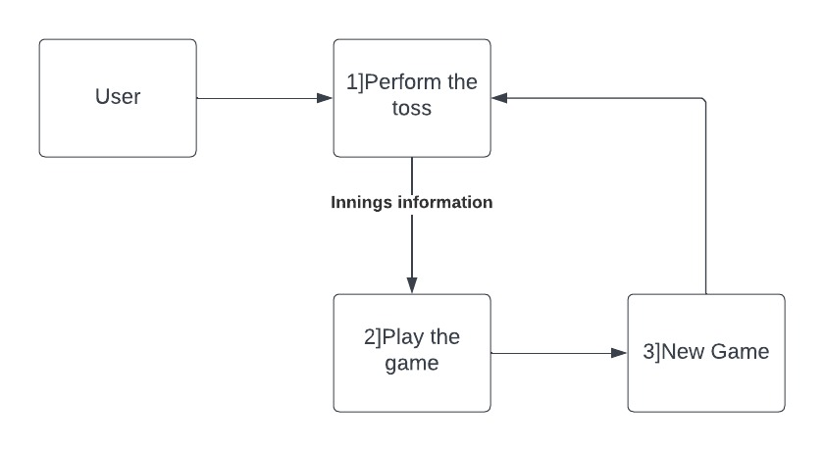
Data Flow Diagram
Level 0

Slide 14
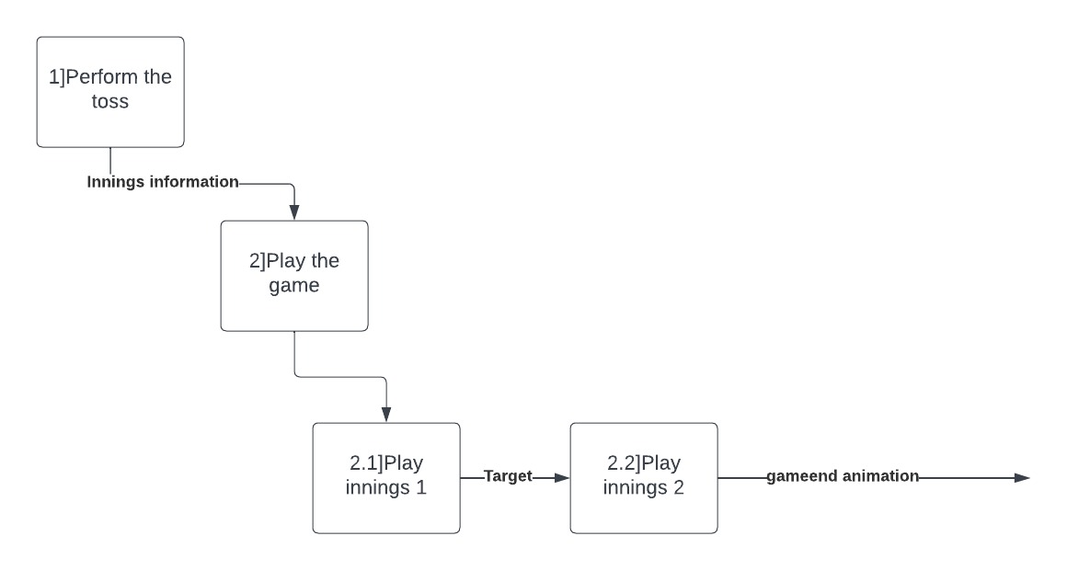
Data Flow Diagram
Level 1

Slide 15
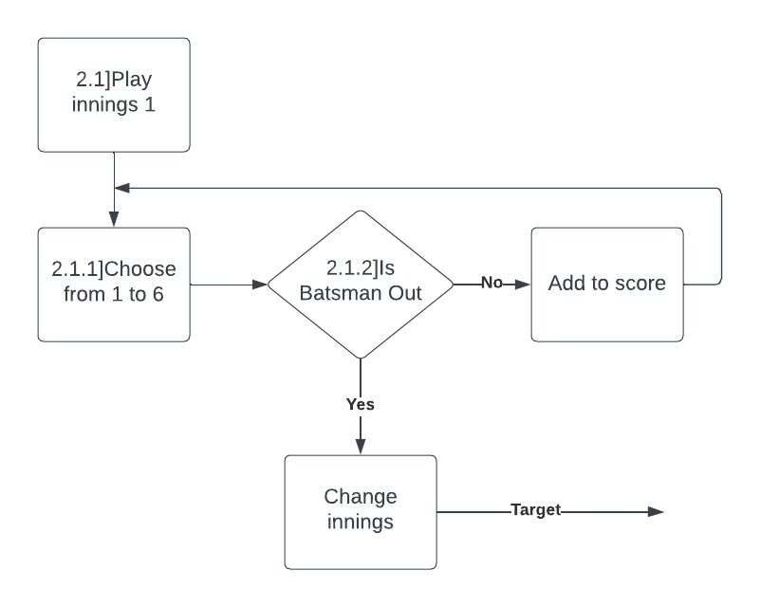
Data Flow Diagram
Level 2

Slide 16
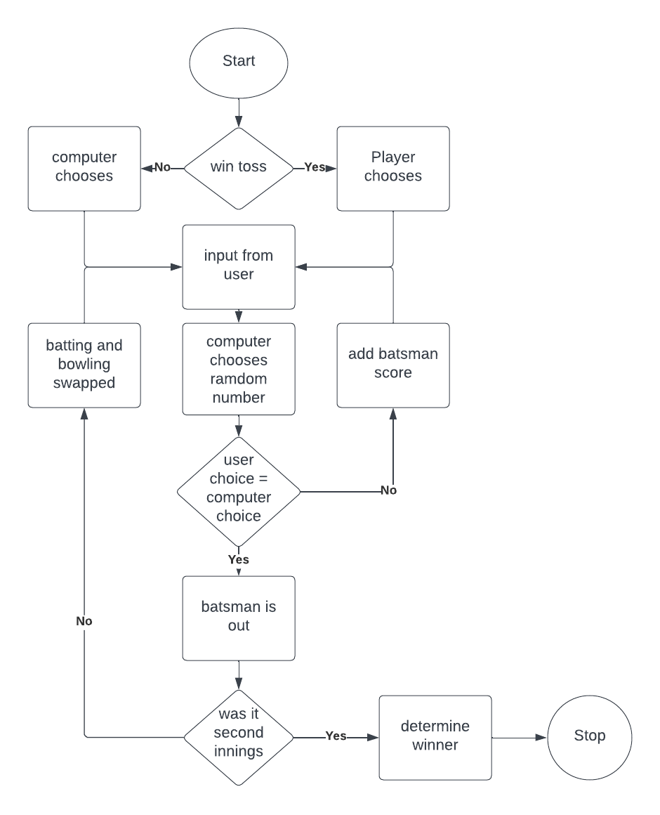
Activity Diagram

Slide 17
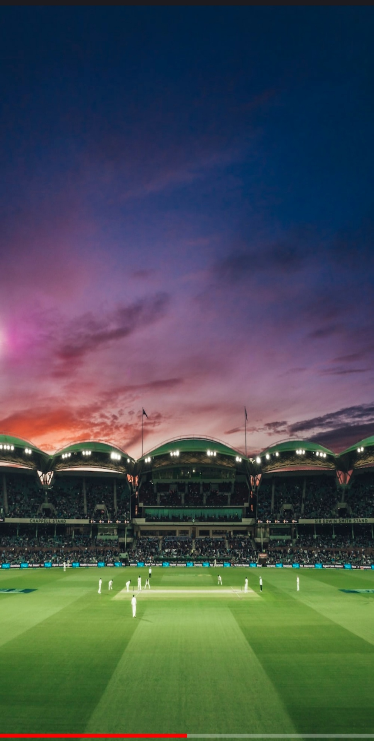
Screenshots
Loading Activity
This activity is the first to be displayed when the application is launched.
It only consists of a loading bar at the bottom.

Slide 18
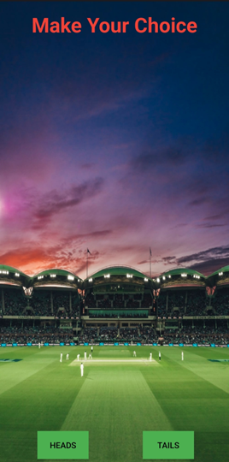

Screenshots
Toss Activity
This activity is the next to be displayed.
It allows the user to select their input for the toss.
If user wins, they are allowed to choose between batting and bowling. Else, computer chooses.

Slide 19
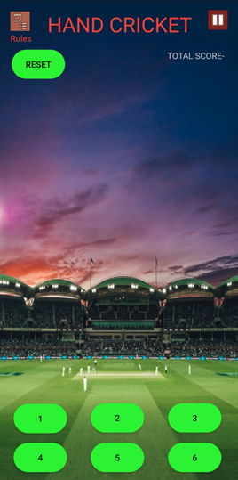
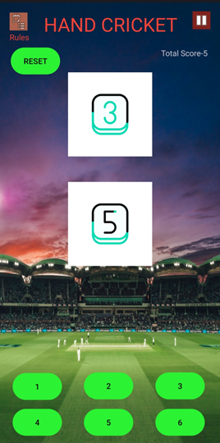
Screenshots
Main Activity
This activity is the heart of the application.
It allows the user to select their input for the main algorithm.

Slide 20
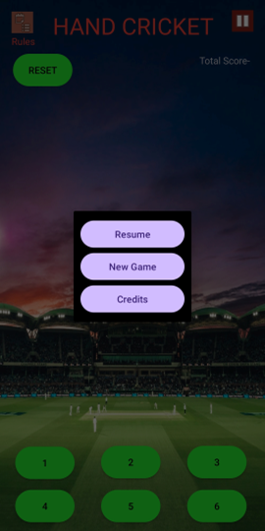
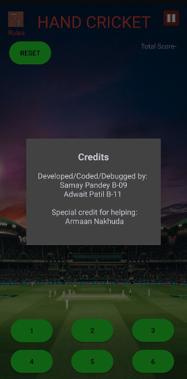
Screenshots
Pause Menu
The pause menu displays the option to start a completely new game.
The credits menu displays the developers information.

Slide 21
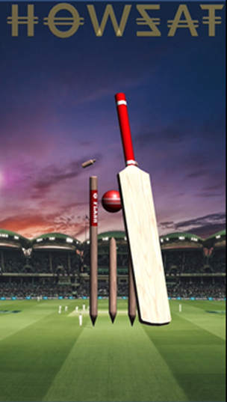
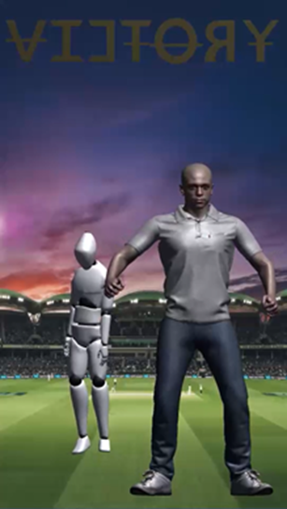
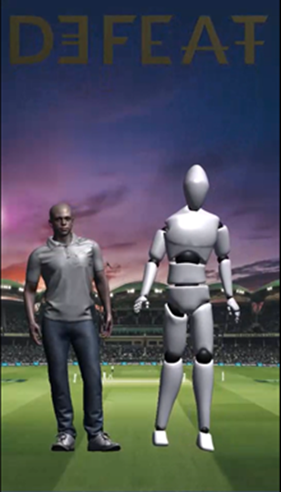
Screenshots
Animations
Animations have been included in the application for a more immersive experience.
The animations are made using Unity.

Slide 22
Thank You!!!

